Slide 1
Lecture 1-2:
Biology, Scopes of Biology and Characteristics of Life
Md. Latiful Bari, Ph.D.
E-mail: latiful@du.ac.bd
BIO-103 course

Slide 2
What is biology?
The word biology comes from the Greek words:
bios, = means life, and
logos,= means thought.
Thus, biology is the science that deals with the study of life.
BIO-103 course

Slide 3
Importance of Biology
Biology is a natural science which studies living organisms and how they interact with each other and their environment.
It examines the structure, function, growth, origin, evolution, and distribution of living things. Also, it classifies and describes organisms, their functions, and how species come into existence.
Biology is important because it is used in every field. Without understanding biology we cannot understand the environment in which we are living.
Biology contains so many secrets of nature. Biology is a vast and complex subject. It tells us about Human Body and its functions and physical makeup of our bodies, which enables us to produce cures and treatment for diseases.
Biology tells us about different plants and their mechanism of converting carbon dioxide in to oxygen which is very important for everybody.
Biology tells us about the most difficult and dire challenges faced by humans.
BIO-103 course

Slide 4
Scopes of Biology for non major science
Biology is of great importance in a practical sense. There are many scopes for biology –
1. Anthropology: The science of man and mankind including the study of the physical and mental constitution of man. It also deals cultural development, social condition, as exhibited both in present and past.
2. Biotechnology: It deals with the living organism or the substances obtained from them and its use in industrial process.
3. Food technology: Science of processing and preserving food.
4. Biomedical Engineering: Biomedical engineering (BME) is the application of engineering principles and design concepts to medicine and biology for healthcare purposes (e.g. diagnostic or therapeutic).
BIO-103 course

Slide 5
Scopes of Biology for non major science
5. Veterinary medicine: Veterinary medicine is the branch of medicine that deals with the prevention, diagnosis and treatment of disease, disorder and injury in animals. The scope of veterinary medicine is wide, covering all animal species, both domesticated and wild, with a wide range of conditions which can affect different species.
6. Medicine: Science of treating disease with drug and curative agents.
7. Forensic Science: The field of Forensic science involves investigating of a crime with the help of applying scientific principles.
8. Geology: Geology is the study of earth and everything related to its structure, processes including study of organisms inhabited on earth. Geology also comprises study of oceanography, hydrogeology, geostatistics.
9. Bioinformatics: an interdisciplinary field that develops methods and software tools for understanding biological data. As an interdisciplinary field of science, bioinformatics combines computer science, statistics, mathematics and engineering to study and process biological data.
BIO-103 course

Slide 6
Basic Principles of Biology
The foundation of biology as it exists today is based on five basic principles. They are the cell theory, gene theory, evolution, homeostasis, and laws of thermodynamics.
Cell Theory: all living organisms are composed of cells. The cell is the basic unit of life.
Gene Theory: traits are inherited through gene transmission. Genes are located on chromosomes and consist of DNA.
Evolution: any genetic change in a population that is inherited over several generations. These changes may be small or large, noticeable or not so noticeable.
Homeostasis: ability to maintain a constant internal environment in response to environmental changes.
Thermodynamics: energy is constant and energy transformation is not completely efficient.
BIO-103 course

Slide 7
Definition of Biology
Biology is the study of living things and the things that were once alive, together with the matter and energy that surround them.
Biology is defined as the science that deals with the study of life together with the factors that affect life.
BIO-103 course

Slide 8
What is life? What is the difference between a living and a nonliving thing?
Living and nonliving things alike are composed of elements. However, there are major differences between a nonliving object and a living organism. To understand what makes a living thing alive, we need to look at the common characteristics that define all life.
BIO-103 course

Slide 9
Characteristics of Living Things
There are nine characteristics of living things.
1. The need for energy
2. Movement
3. Cellular structure and organization
4. Growth and development
5. Maintaining Homeostasis and Repair
6. Reproduction
7. Response to stimuli
8. Variation and adaptation
9. Metabolism
BIO-103 course

Slide 10
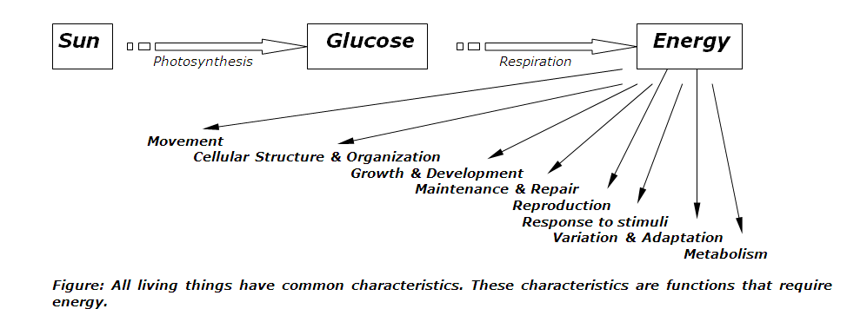
1. The Need for Energy
BIO-103 course

Slide 11
The Need for Energy
All organisms need energy for their metabolic activities.
Almost all the energy used by living things comes originally from the sun. Green plants, through photosynthesis, store some of the sun’s energy in compounds such as glucose.
Some organisms capture energy from the sun and convert it into chemical energy in food; others use chemical energy in molecules they take in as food
BIO-103 course

Slide 12
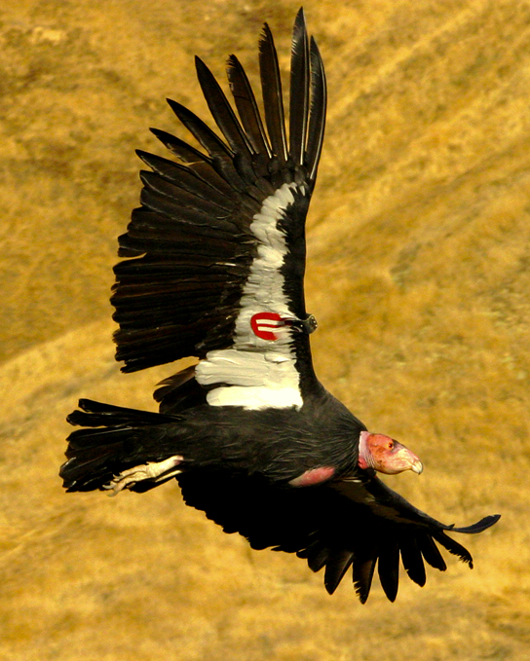
Need Energy : Example
The California condor (Gymnogyps californianus) uses chemical energy derived from food to power flight
BIO-103 course

Slide 13
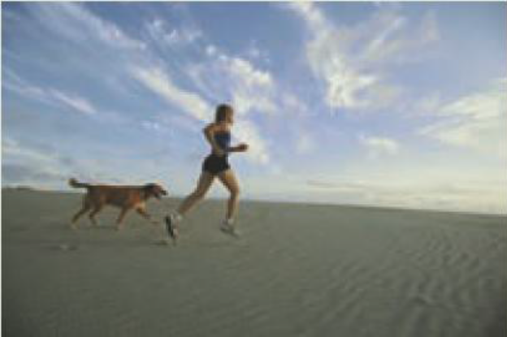
2. Movement
One of the most obvious characteristics of living things is movement. Most animals show obvious signs of movement when they are alive.
Although movement in plants is not as obvious, it does occur. This movement can be very slow, such as (1) the opening of buds on a tree or (2) the turning of leaves of a plant toward the sun.
BIO-103 course

Slide 14
3. Cellular Structure and Organization
Living Things are Composed of Cells:
Single-cell organisms have everything they need to be self-sufficient.
In multicellular organisms, specialization increases until some cells do only certain things.
Living Things Have Different Levels of Organization:
Both molecular and cellular organization.
Living things must be able to organize simple substances into complex ones.
Living things organize cells at several levels:
  Tissue - a group of cells that perform a common function.
  Organ - a group of tissues that perform a common function.
  Organ system - a group of organs that perform a common function.
  Organism - any complete living thing.
BIO-103 course

Slide 15
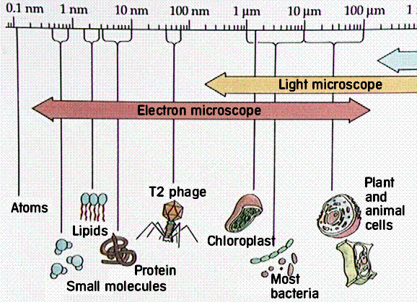
Cellular Structure and Organization
However, from bacteria and amoebas to trees and humans, the cell is the basic unit in which substance are organized to produce a living thing.
BIO-103 course

Slide 16
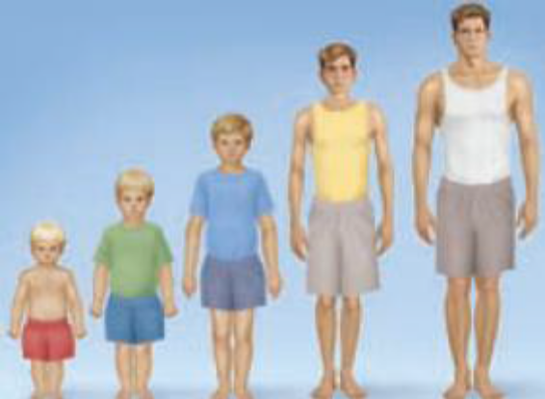
4. Growth and Development
All living things grow at some time during their lives. The total growth may be very small, as in the case of a bacterium or an amoeba. Total growth can be quite extensive, as in the case of a whale or a large tree. Yet, whether great or small, growth is a characteristic of all living things.
The series of changes that take place as an organism grows toward its final form is called development. All living things undergo development.
BIO-103 course

Slide 17
5. Maintaining Homeostasis and Repair
In order to function properly, cells need to have appropriate conditions such as proper temperature, pH, and appropriate concentration of diverse chemicals. These conditions may, however, change from one moment to the next. Organisms are able to maintain internal conditions within a narrow range almost constantly, despite environmental changes, through homeostasis (literally, "steady state")—the ability of an organism to maintain constant internal conditions.
For example, Organisms that live in cold climates, such as the polar bear , have body structures that help them withstand low temperatures and conserve body heat. Structures that aid in this type of insulation include fur, feathers, blubber, and fat. In hot climates, organisms have methods (such as perspiration in humans or panting in dogs) that help them to shed excess body heat.
BIO-103 course

Slide 18
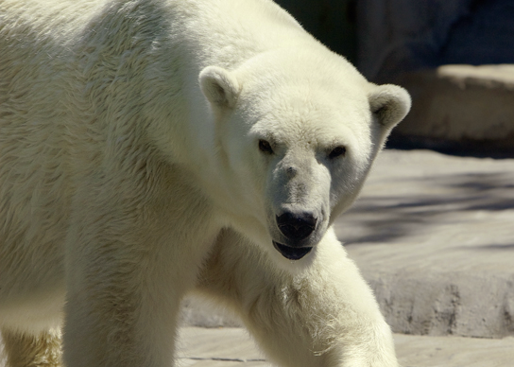
Homeostasis : Example
Polar bears (Ursus maritimus) and other mammals living in ice-covered regions maintain their body temperature by generating heat and reducing heat loss through thick fur and a dense layer of fat under their skin.
BIO-103 course

Slide 19
6.Reproduction
Single-celled organisms reproduce by first duplicating their DNA. They then divide it equally as the cell prepares to divide to form two new cells.
Multicellular organisms often produce specialized reproductive germline cells that will form new individuals. When reproduction occurs, genes containing DNA are passed along to an organism's offspring.
These genes ensure that the offspring will belong to the same species and will have similar characteristics, such as size and shape .
Reproduction is not essential for the survival of individual organisms, but must occur for a species to survive.
All living things reproduce in one of the following ways:
  Asexual reproduction - Producing offspring without the use of gametes.
  Sexual reproduction - Producing offspring by the joining of sex cells.
BIO-103 course

Slide 20
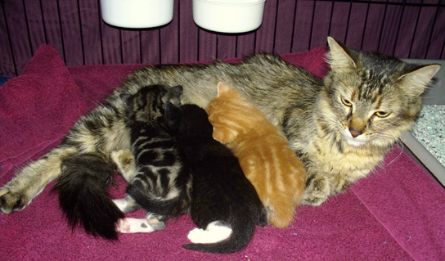
Reproduction: Example
Although no two look alike, these kittens have inherited genes from both parents and share many of the same characteristics.
BIO-103 course

Slide 21
7. Response to Stimuli
Organisms can respond to diverse stimuli. For example, plants can grow toward a source of light, climb on fences and walls, or respond to touch . Even tiny bacteria can move toward or away from chemicals (a process called chemotaxis) or light (phototaxis). Movement toward a stimulus is considered a positive response, while movement away from a stimulus is considered a negative response.
BIO-103 course

Slide 22
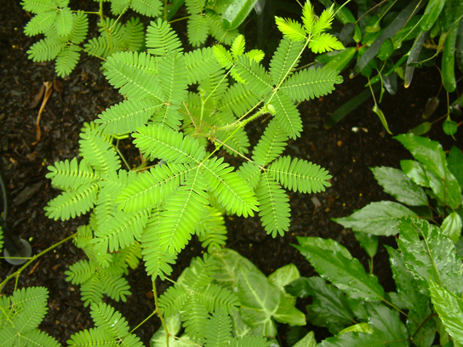
Response to Stimuli Example
The leaves of this sensitive plant (Mimosa pudica) will instantly droop and fold when touched. After a few minutes, the plant returns to normal.
BIO-103 course

Slide 23
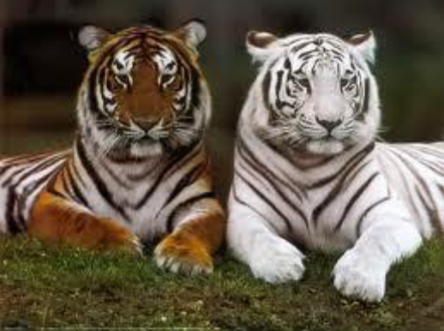
8. Variation and adaptation
Variation Change occurs as a result of a characteristic called variation.
Offspring always differ in some ways from one another and from their parents. These differences are called variations. Most variations do not affect an organism’s chances of survival.
For example, the fact that your hair is a different colour from your parents will not likely affect your chances of survival.
BIO-103 course

Slide 24
8. Variation and adaptation
Adaptations are traits giving an organism an advantage in a certain environment .
There are three basic types of adaptations that can occur in higher organisms
Reversible changes occur as a response to changes in the environment. Let's say you live near sea level and you travel to a mountainous area. You may begin to experience difficulty breathing and an increase in heart rate as a result of the change in altitude. These symptoms go away when you go back down to sea level.
BIO-103 course

Slide 25
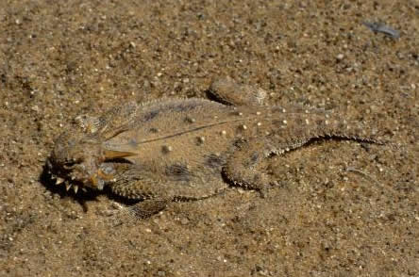
Adaptation: Example
This lizard exhibits a flattened body and coloring that helps camouflage it, both of which are adaptive traits that help it avoid predators.
BIO-103 course

Slide 26
Adaptation
Somatic changes occur as a result of prolonged changes in the environment. Using the previous example, if you were to stay in the mountainous area for a long time, you would notice that your heart rate would begin to slow down and you would begin to breath normally. Somatic changes are also reversible.
The final type of adaptation is called genotypic (caused by genetic mutation). These changes take place within the genetic makeup of the organism and are not reversible. An example would be the development of resistance to pesticides by insects and spiders.
BIO-103 course

Slide 27
9. Metabolism
Metabolism is the exchange of substances and energy between an organism and its environment, and the changes that occur in this substances and energy when they are within the organism.
BIO-103 course

Slide 28
Metabolism
Metabolism has two distinct phases, anabolism and catabolism.
Anabolism is a constructive or building-up phase; it includes assimilation, or building of protoplasm from simple compounds and elements that were obtained as a result of ingestion and digestion. It also includes the process of photosynthesis.
Catabolism is a destructive or breaking-down phase; it involves the release of energy by the breakdown of food materials through respiration.
BIO-103 course

Slide 29
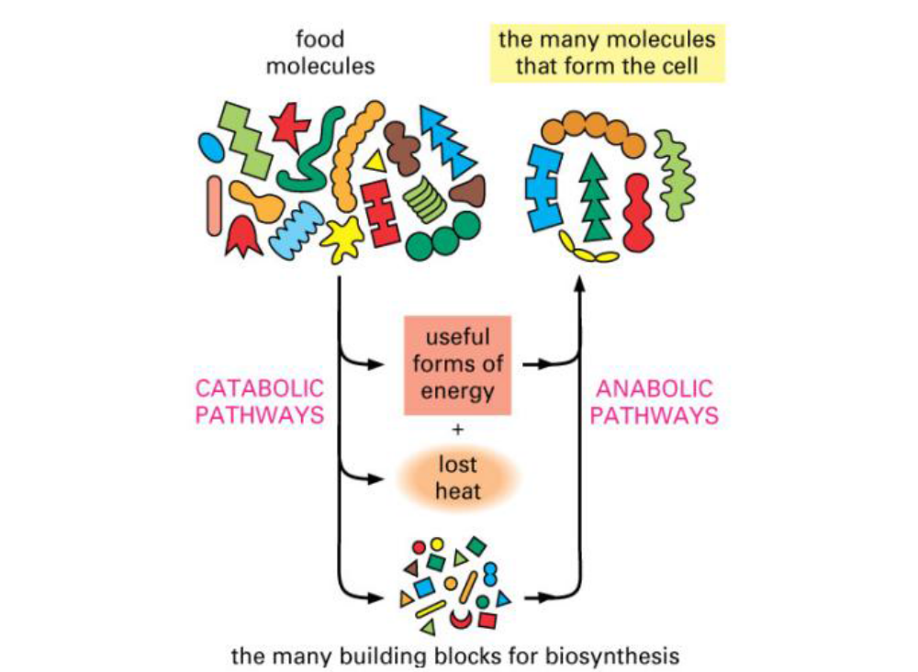
Metabolism: Example
BIO-103 course

Slide 30
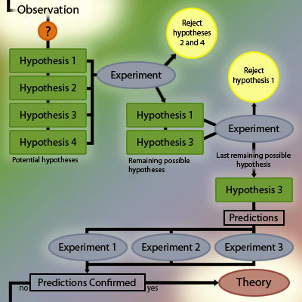
How Science is Done
A diagram that illustrates scientific investigation
BIO-103 course

